Slide 1
Final Project
Trading Strategy
Jiaxin Zhang
Jiaxun Song

Slide 2
Data
United Airline stock information (UAL) from 2007 to 2017
Vanguard Energy Index Fund ETF Shares (VDE)
Boeing (BA)
Airbus (AIR.PA)
S&P 500 Index (^GSPC)
Dow Jones Index (^DJI)
NYSE Arca Airline Index (^XAL)
Delta Airline (DAL)
Jetblue Airline (JBLU)

Slide 3
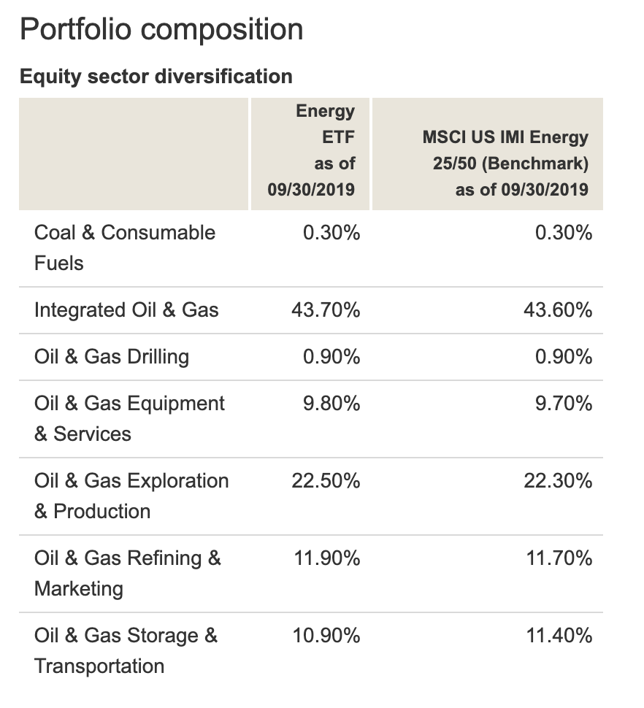
Data
Composition of Vanguard Energy Index Fund ETF Shares (VDE)
Good indicator of the whole Oil & Gas industry
https://investor.vanguard.com/etf/profile/VDE

Slide 4
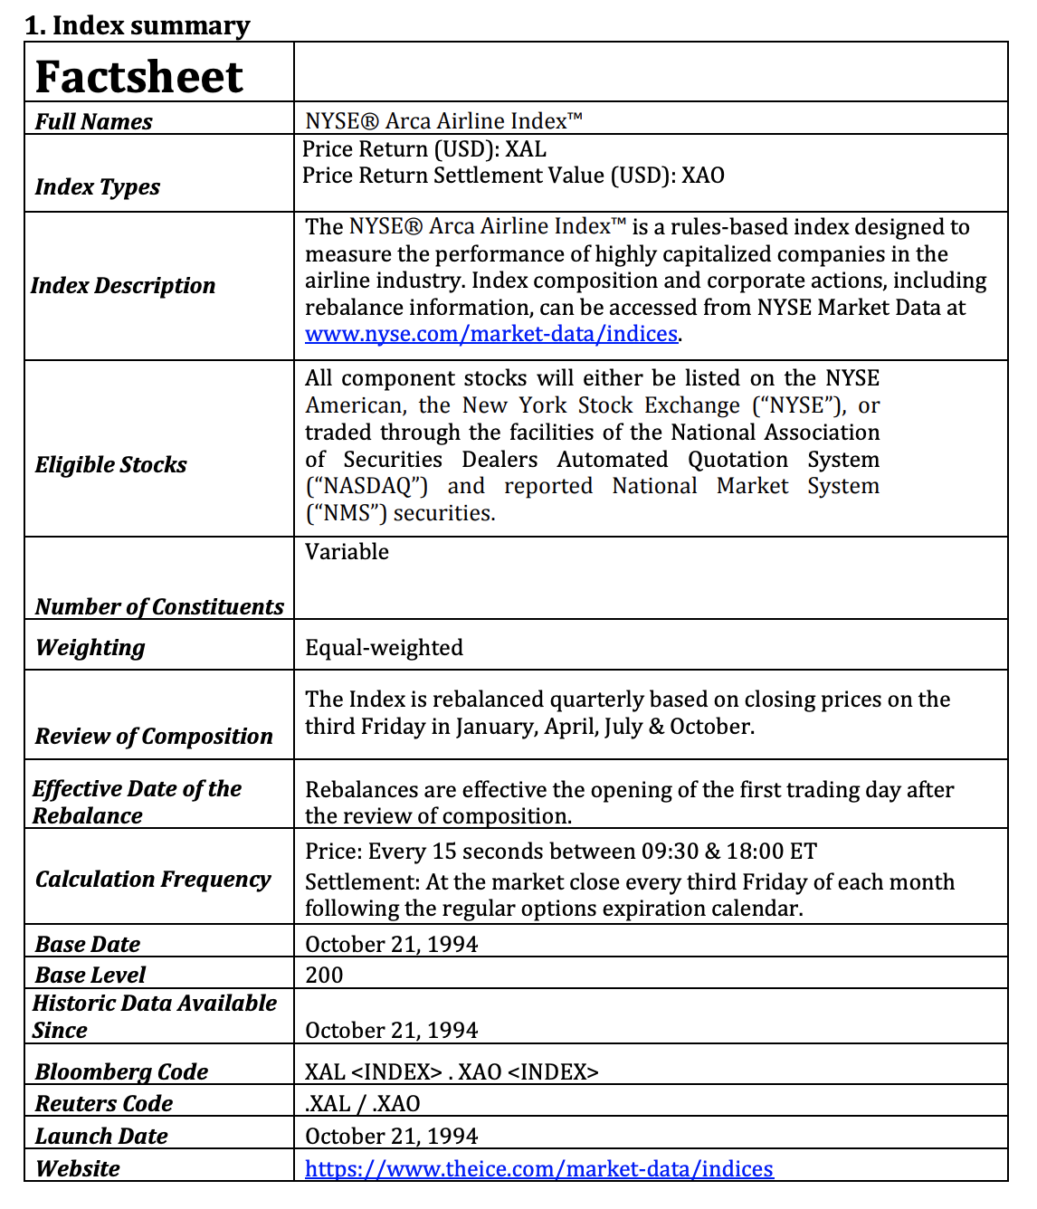
Data
NYSE Arca Airline Index (^XAL)
Rules-based index designed to measure the performance of highly capitalized companies in the airline industry.
Good indicator of the overall airline industry.

Slide 5
Methodology
Parameters: Open, Close, High, Low and Volume of UAL,
S&P 500 Index (^GSPC), Dow Jones Index (^DJI),
AdjClosing Price of VDE, NYSE Arca Airline Index (^XAL),
Price of related stocks: Delta, Jetblue, Boeing and Airbus
Machine Learning methods:
Decision Tree
Random Forest
SVM

Slide 6
Methodology
Naive Trading Strategy:
All in at the first day, all out at the last day.
Market Assumption:
Assume 80% probability we can trade stocks at closing price
Trading Strategies:
Moving Average
Support and Resistance

Slide 7
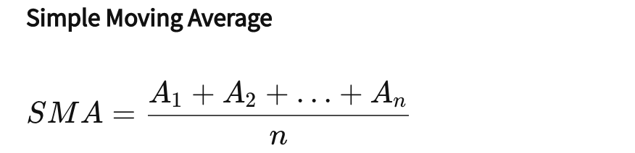
Trading Strategy - Moving Average
Crossover of two MAs:
Apply two moving averages to a chart: one longer and one shorter.
When the shorter-term MA crosses above the longer-term MA, it's a buy signal, as it indicates that the trend is shifting up. This is known as a "golden cross." [label = 1]
Meanwhile, when the shorter-term MA crosses below the longer-term MA, it's a sell signal, as it indicates that the trend is shifting down. This is known as a "dead/death cross." [label = -1]
Where:
A: Adj Closing price for each day
n: number of days
Notes:
A moving average can be calculated in different ways. A five-day simple moving average (SMA) adds up the five most recent daily closing prices and divides it by five to create a new average each day. Each average is connected to the next, creating the singular flowing line.

Slide 8
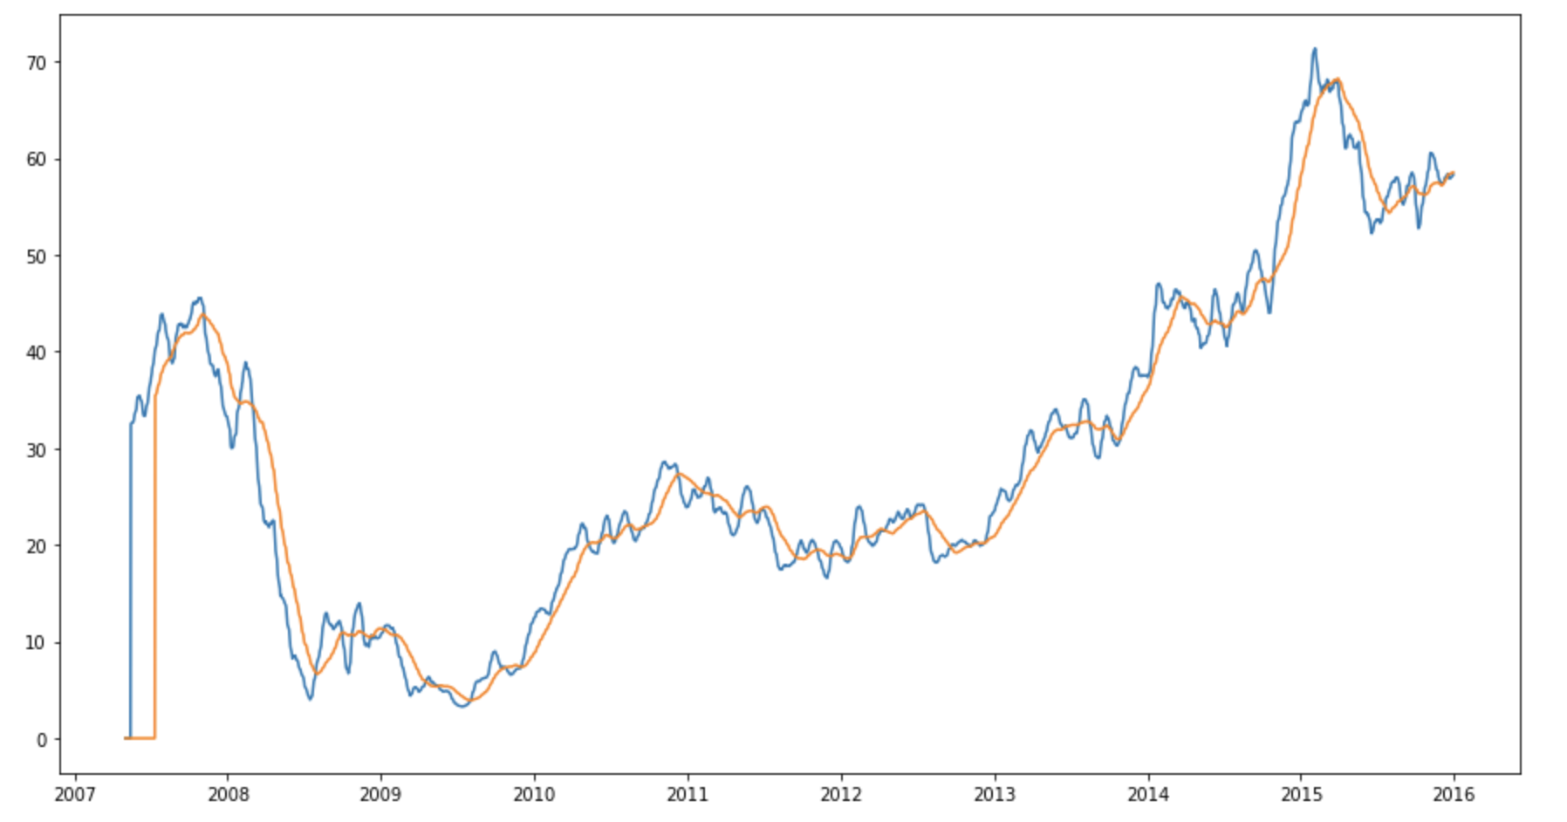
Trading Strategy - Moving Average
10-Day Moving Average
50-Day Moving Average

Slide 9
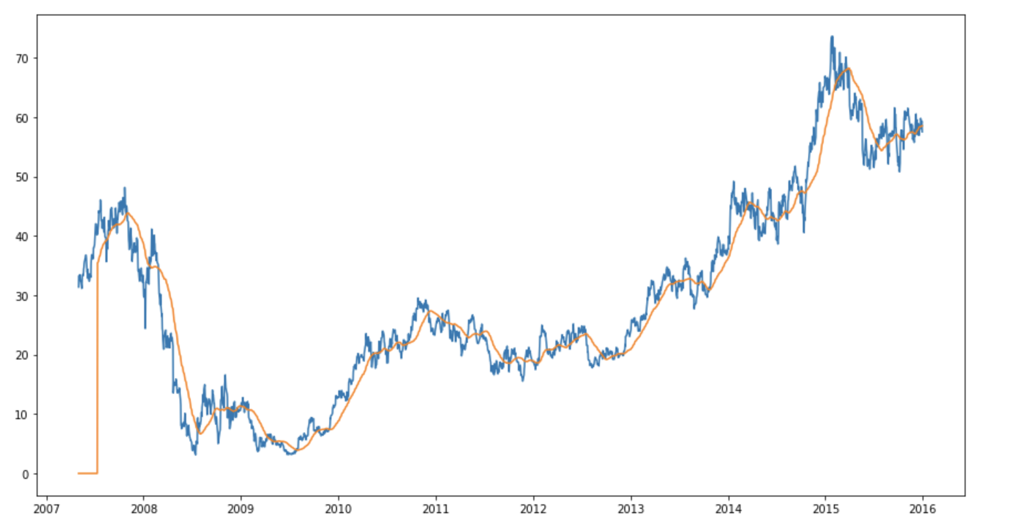
Trading Strategy - Moving Average
Price Crossover
Price crossover, which is when the price crosses above or below a moving average to signal a potential change in trend.
In our project, we use the modification of this strategy.

Slide 10
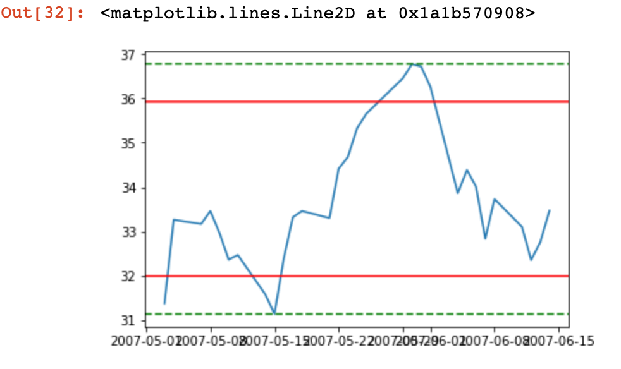
Trading Strategy - Support and Resistance
Resistance:
Resistance occurs where an uptrend is expected to pause temporarily.
Support:
Support is a price level where a downtrend can be expected to pause.

Slide 11
Trading Strategy - Support and Resistance
Buy all stocks when the Adj Price goes below the Support level,
Sell all stocks when the Adj Price goes above the Resistance level,
Otherwise, Hold the stock.

Slide 12
Results
We invest $10,000 to test the strategies.
Strategy | Return | P/L | Profit Ratio
Naïve Strategy | 16405 | 6405 | 64%
Random Forest | 16524 | 6524 | 65%
SVM | 16497 | 6497 | 65%
Decision Tree | 18257 | 8257 | 83%

Slide 13
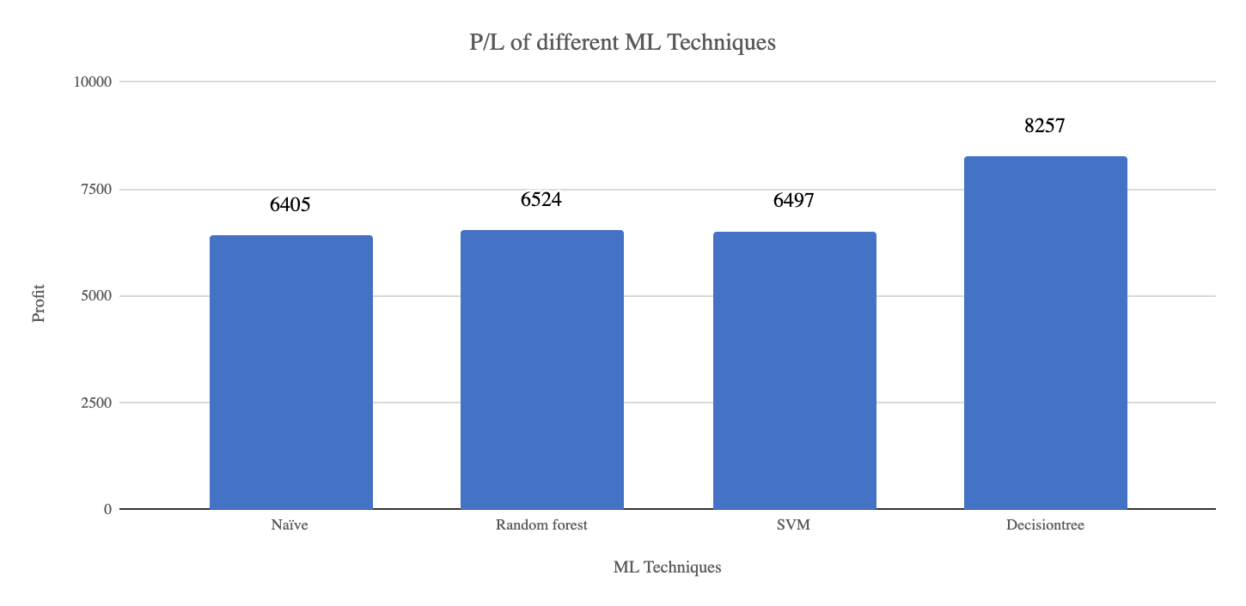
Results
The data is non-linear data, and Decision Tree works best for non-linear data.

Slide 14
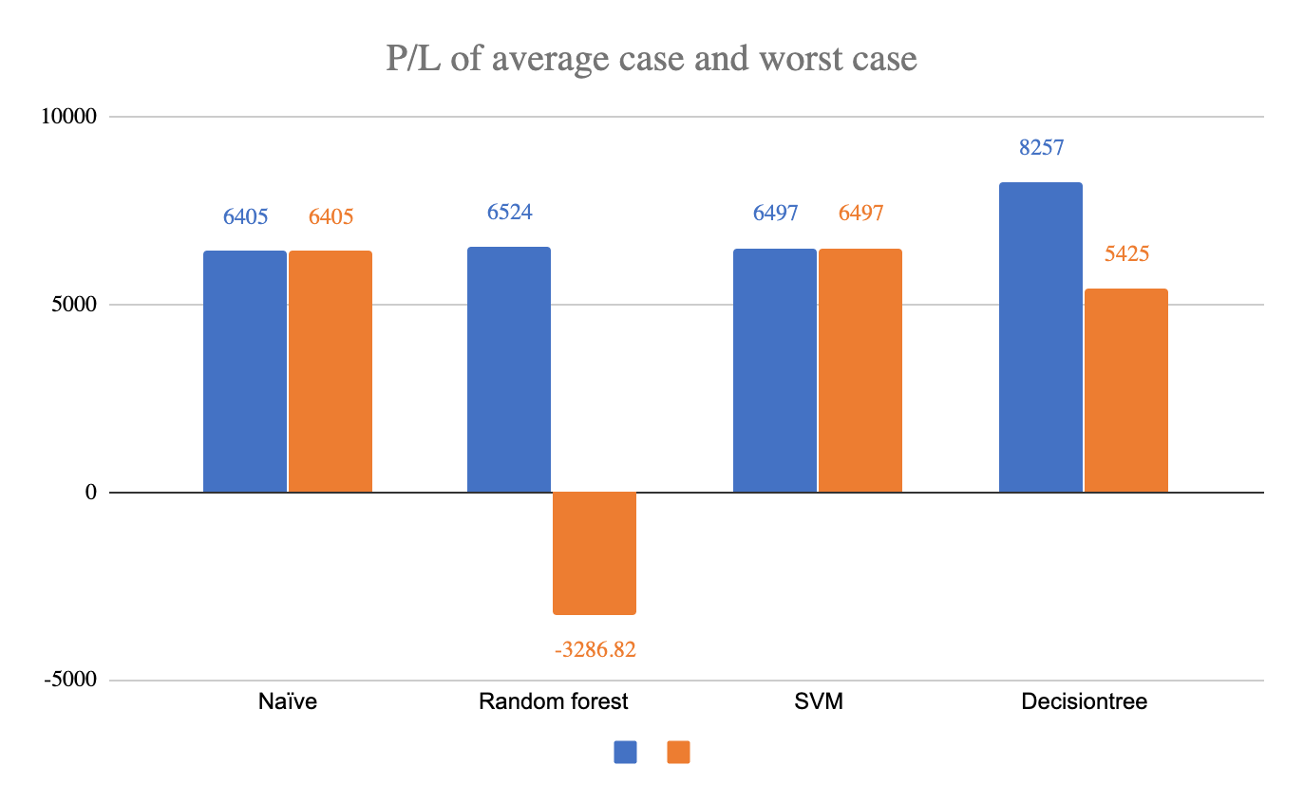
Results
Worst Case Scenario:
Buy at the highest price in a day
Sell at the lowest price in a day.
Strategy | Return | P/L | Profit Ratio
Naïve | 16405 | 6405 | 64.05%
Random Forest | 6713.18 | -3286.82 | -32.87%
SVM | 16497 | 6497 | 64.97%
Decision Tree | 15425 | 5425 | 54.25%
Average case Worst Case

Slide 15
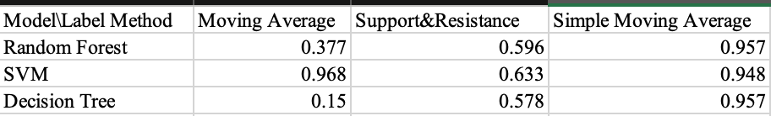
Results
Accuracy scores for different trading strategies and different models:

Slide 16
Conclusion
We modified the ways of labeling the data. (-1:sell, 1: buy, 0:hold)
The Moving Average and Support & Resistance trading strategies make positive profits, but less than the naive trading strategy.
The simple moving average strategy turns out to be the best among the three trading strategies, because the models’ accuracy scores for the other two strategies are low.
Decision Tree makes the highest profit.
We also tried Neural network. When we label the data by “moving average crossover” method and ”rolling window“ method, the neural network is unable to predict any “1” or “-1”, because the labels are mostly “0”.

Slide 17
Improvement
Use more related parameters to fit the model
Use larger amount of data to fit the model
Try exponential moving average
Try the trading strategy on other stocks
Try not to use “all in” strategy
Notes:
An exponentially weighted moving average reacts more significantly to recent price changes than a simple moving average (SMA),

Slide 18
Thank you

